Slide 1



SimplyFly – Air Ticket Booking
By Srimathi R

Slide 2




PROBLEM STATEMENT
The goal of SimplyFly is to bridge the gap between passengers and flight providers by digitizing the ticket booking process. Traditional booking systems can be cumbersome or disjointed, especially when comparing schedules, managing cancellations, or handling refunds. SimplyFly solves this with a unified, modern web app.
03
01

Slide 3
TECH STACK
03
LAYER | TECHNOLOGY
FRONTEND | Angular
BACKEND | Spring Boot
DATABASE | MYSQL
SECURITY | JWT
01

Slide 4
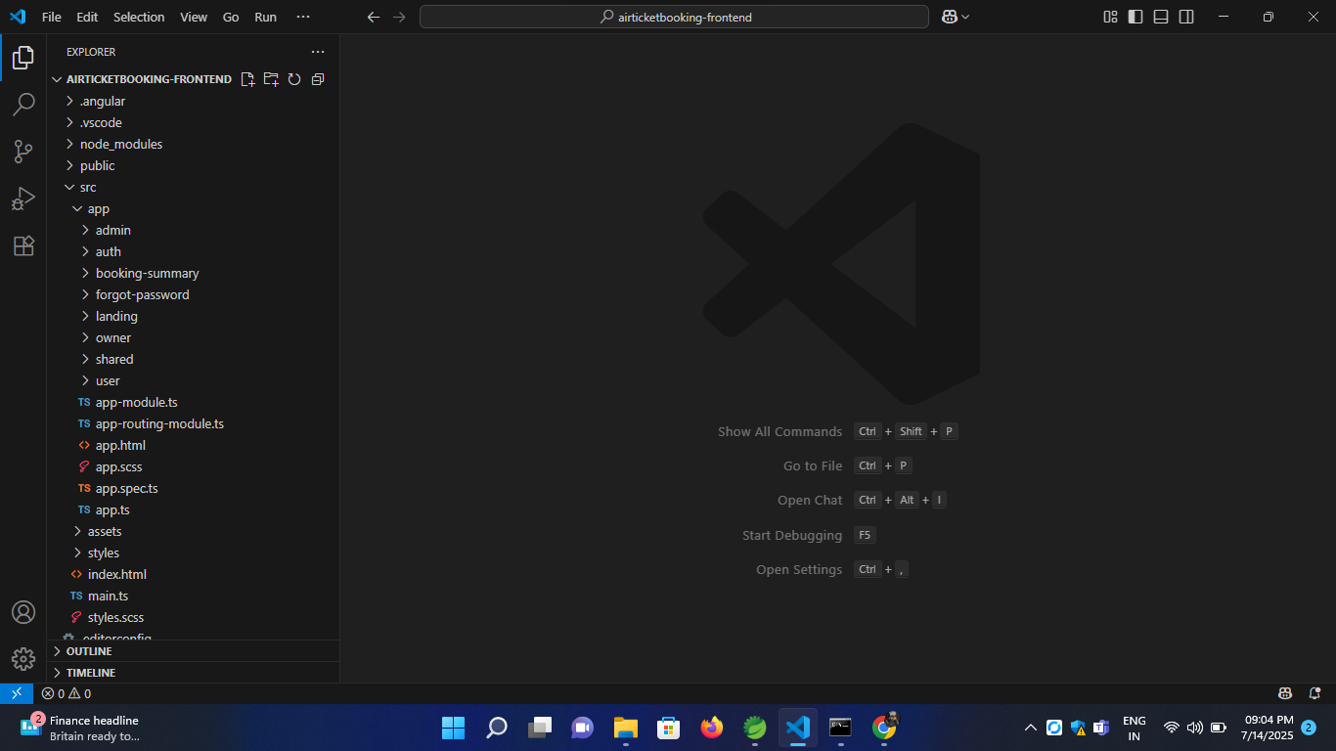
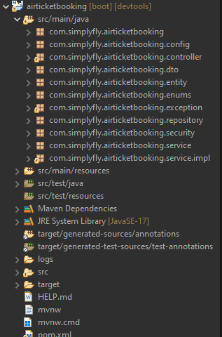
PROJECT STRUCTURE
FRONTEND
BACKEND
03
01

Slide 5
SECURITY
03
I implemented JWT-based authentication to ensure secure sessions.
After login, users receive a signed token which is used for all further requests.
This ensures only authorized users can access protected routes.
01

Slide 6
UNIT TESTING - Mockito
SAMPLE TEST CASE
@Mock private FlightRepository flightRepository;
@InjectMocks private FlightServiceImpl flightService;
@Test
void testAddFlight() {
AddFlightRequest request = new AddFlightRequest("AI101", "Air India", 1L, 60, 4500.0, "15kg", "7kg", LocalDateTime.now(), LocalDateTime.now().plusHours(2));
when(authentication.getName()).thenReturn("admin@example.com");
when(routeRepository.findById(1L)).thenReturn(Optional.of(route));
when(userRepository.findByEmail("admin@example.com")).thenReturn(Optional.of(user));
when(flightRepository.save(any(Flight.class))).thenReturn(flight);
flightService.addFlight(request, authentication);
verify(flightRepository).save(any(Flight.class));
verify(seatRepository).saveAll(anyList());
}
03
01

Slide 7
CORE FEATURES
1. User/Passenger:
Register/Login securely using JWT
Search for flights using origin, destination, and date
Seat availability
Fare and baggage info
Select multiple seats and view total price
Make bookings
View/cancel booking history
03
01

Slide 8
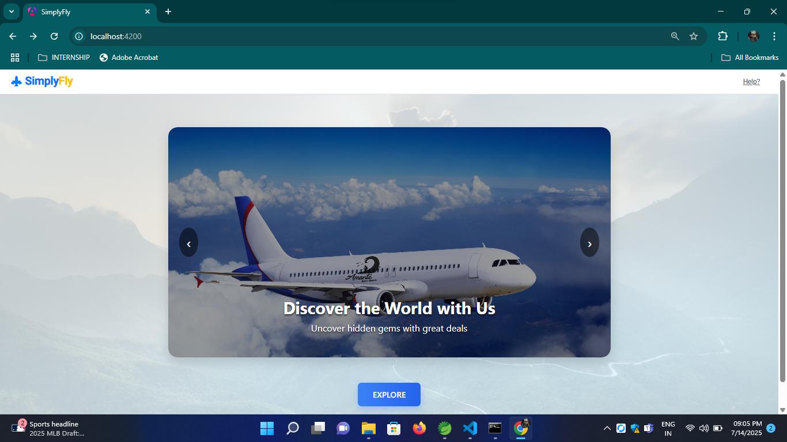
03
01
LANDING PAGE

Slide 9
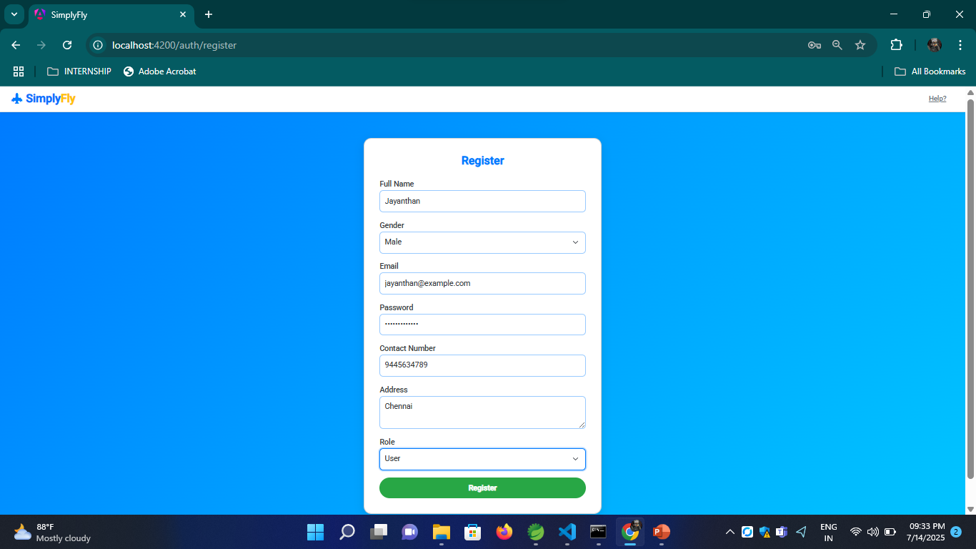
03
01
Register

Slide 10
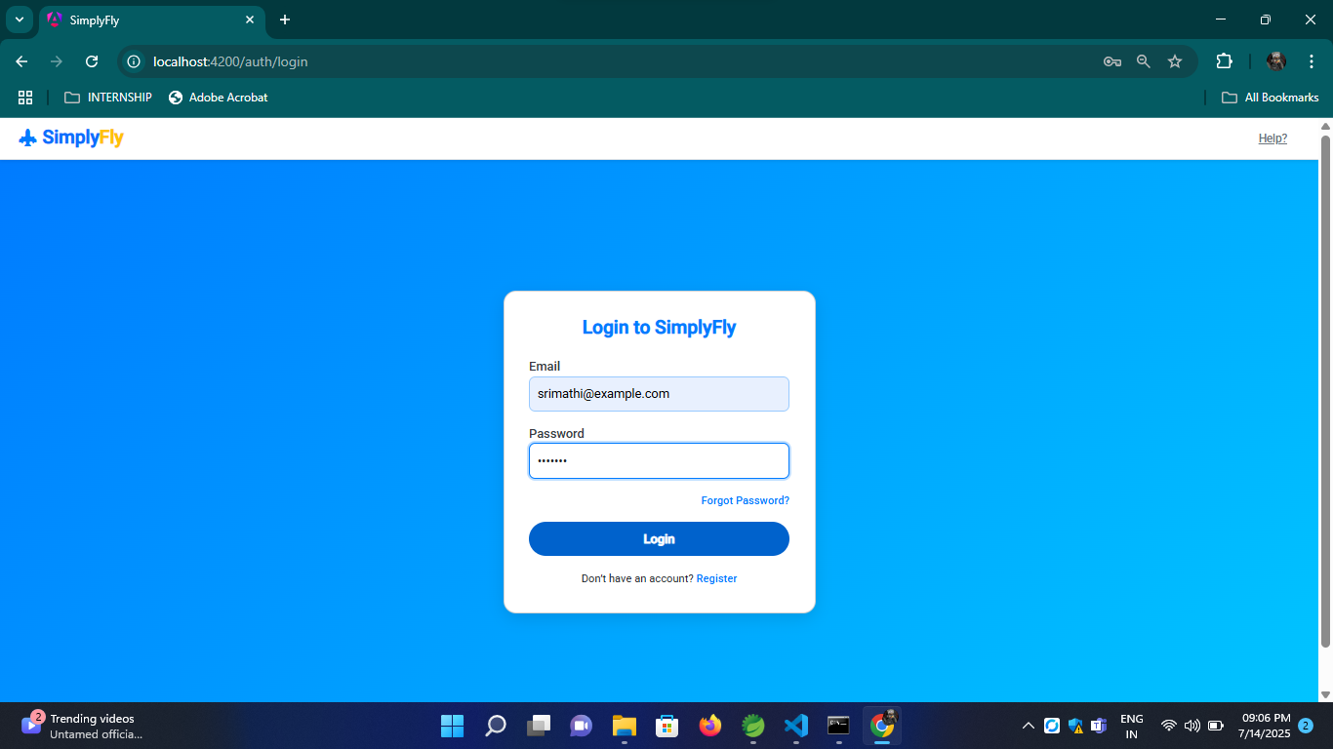
03
01
Login

Slide 11
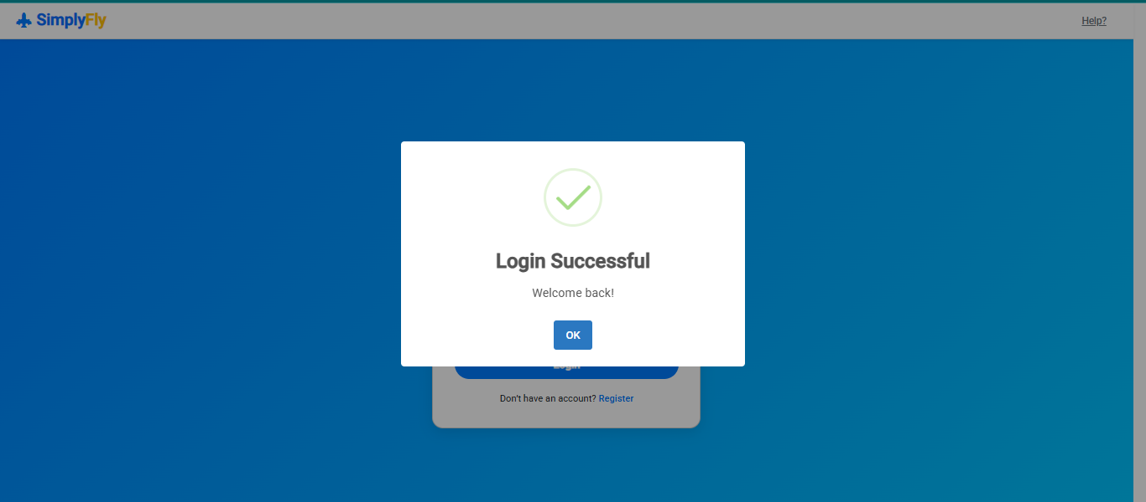
03
01
Logged In

Slide 12
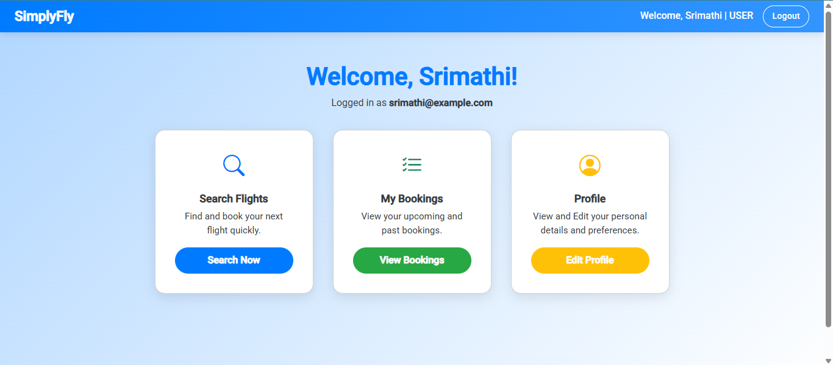
03
01
DASHBOARD

Slide 13
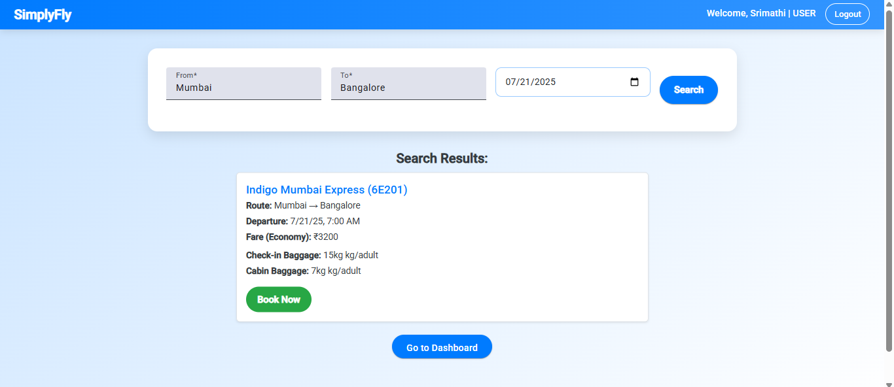
03
01
Search Flight

Slide 14
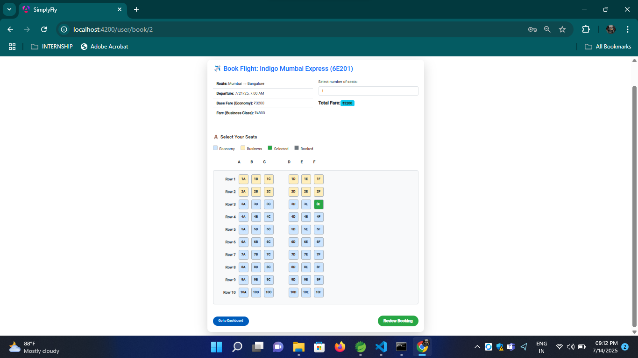
03
01
Book Flight

Slide 15
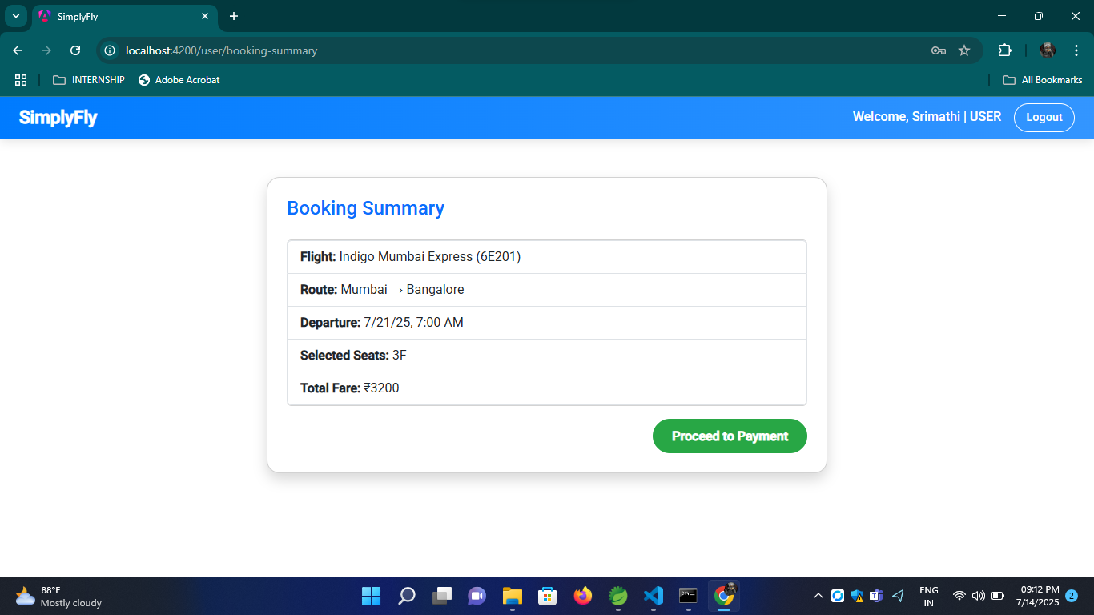
03
01
Booking Summary

Slide 16
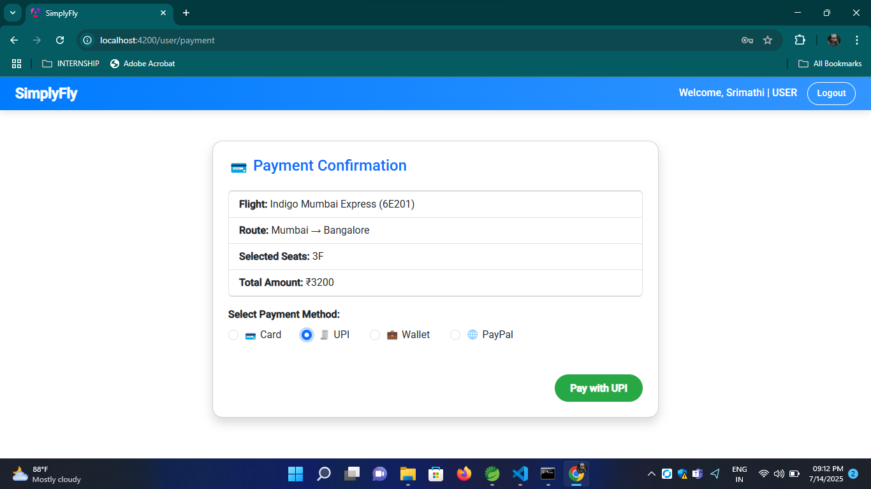
03
01
Make Payment

Slide 17
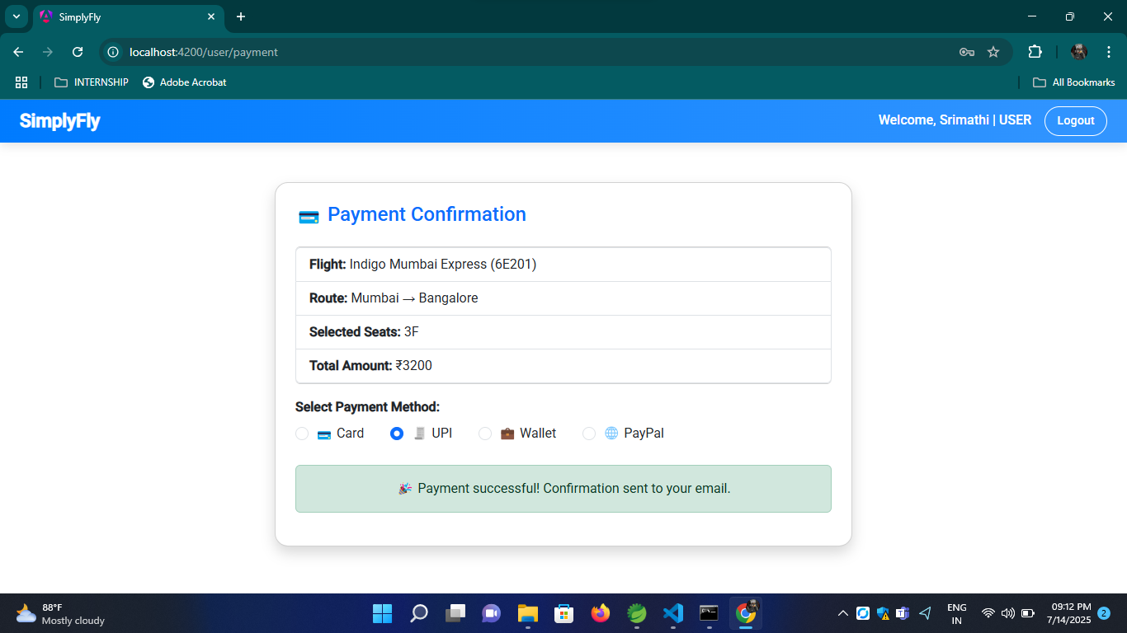
03
01
Payment Confirmation

Slide 18
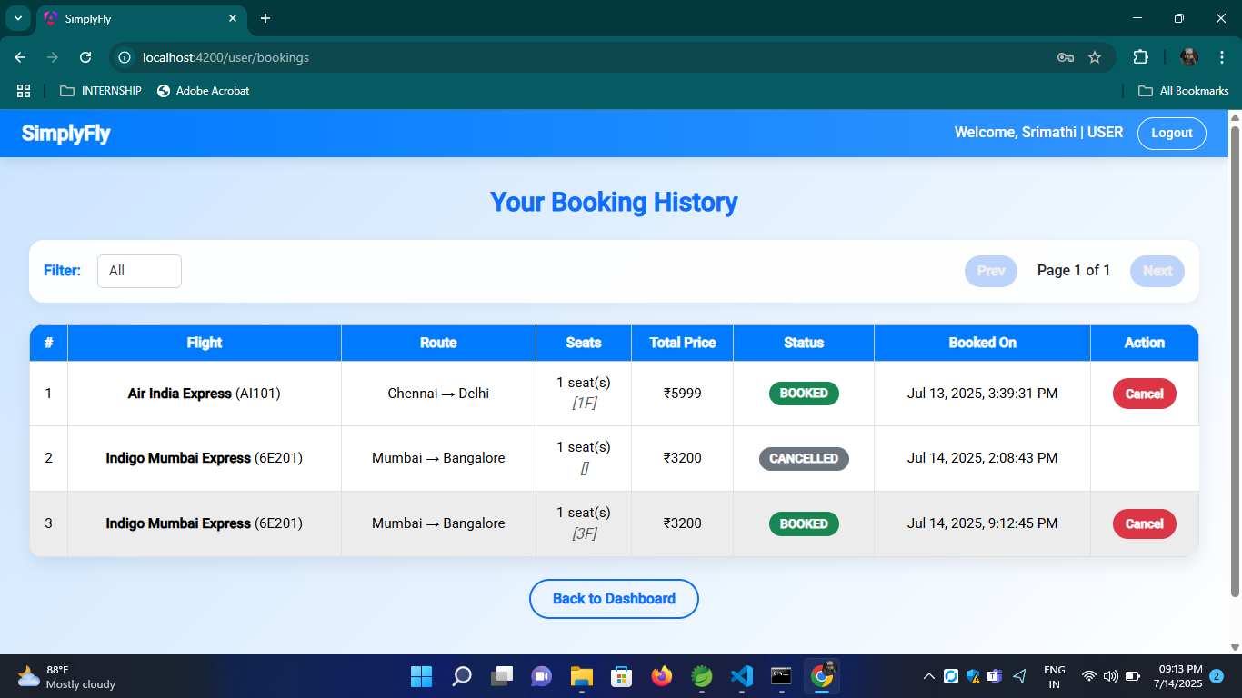
03
01
View Booking History / Cancel Booking

Slide 19
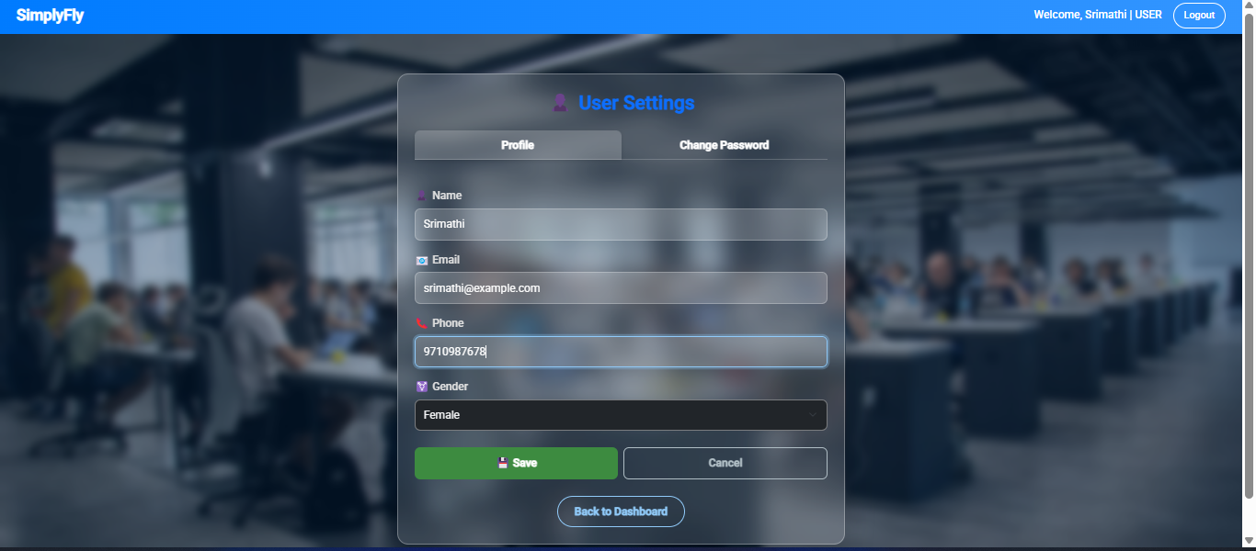
03
01
Edit User Profile

Slide 20
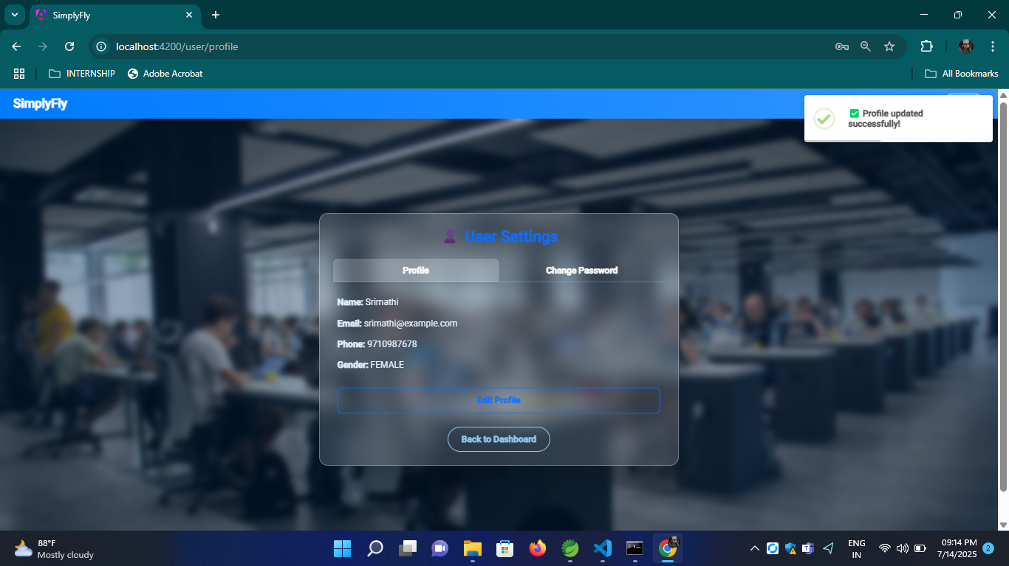
03
01
Update Confirmation

Slide 21
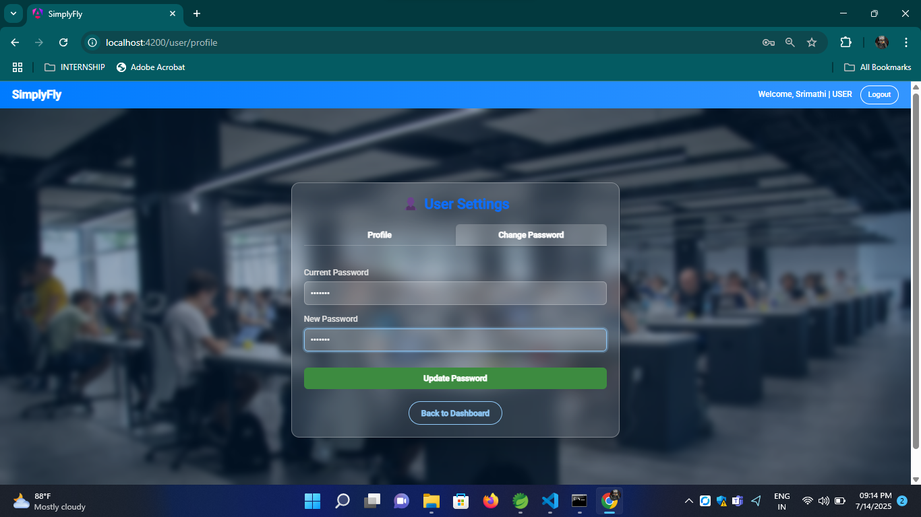
03
01
Change Password

Slide 22

03
01
Update Password Confirmation

Slide 23
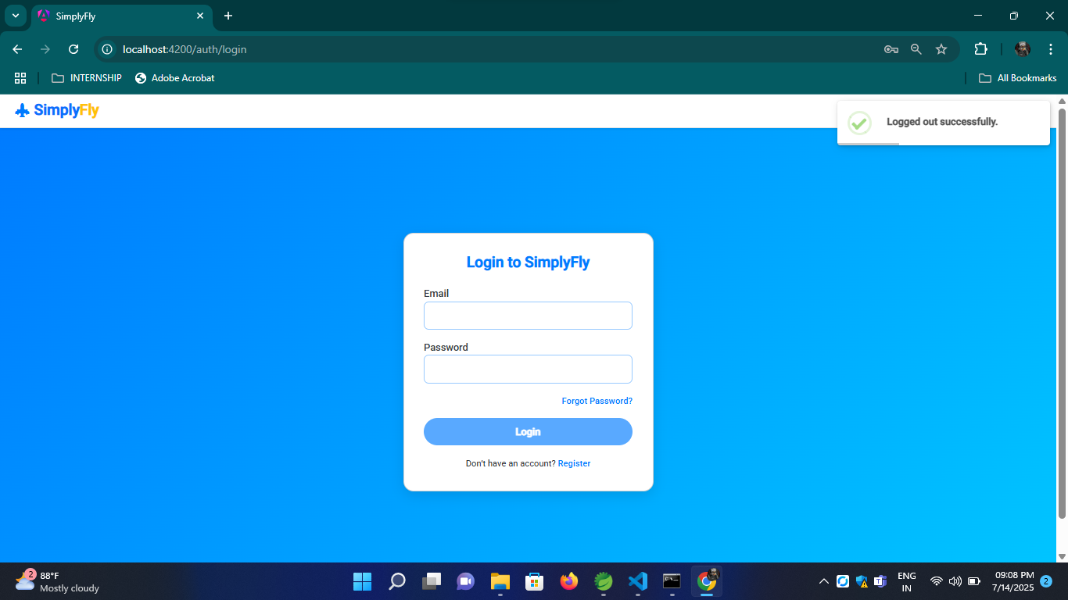
03
01
Logged Out

Slide 24
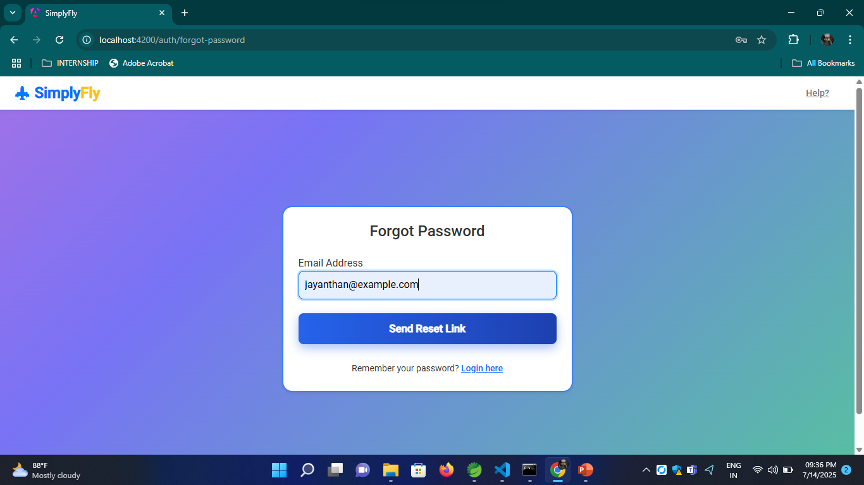
03
01
Request Reset Password

Slide 25
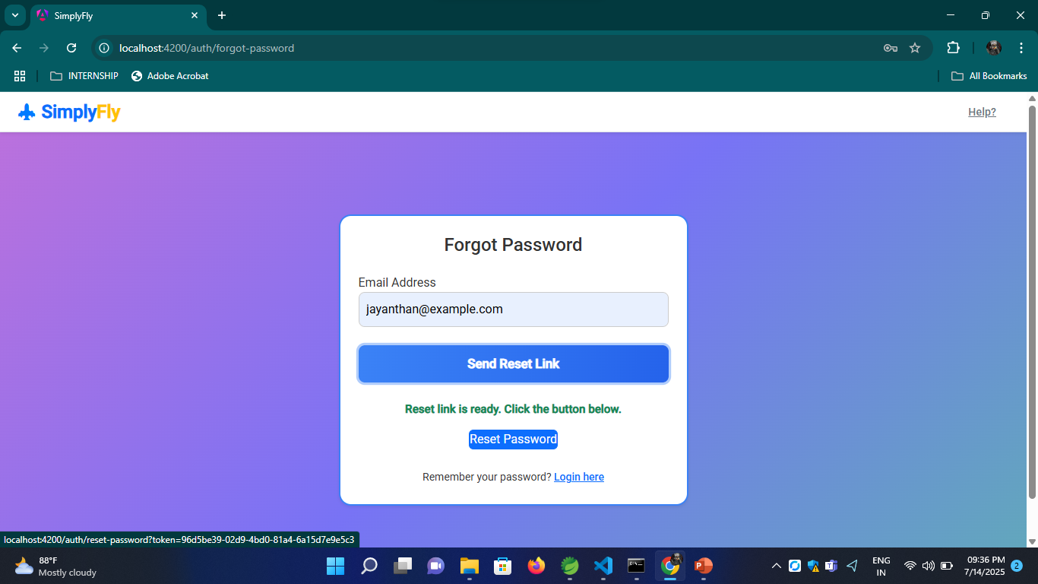
03
01
Reset Password Link

Slide 26
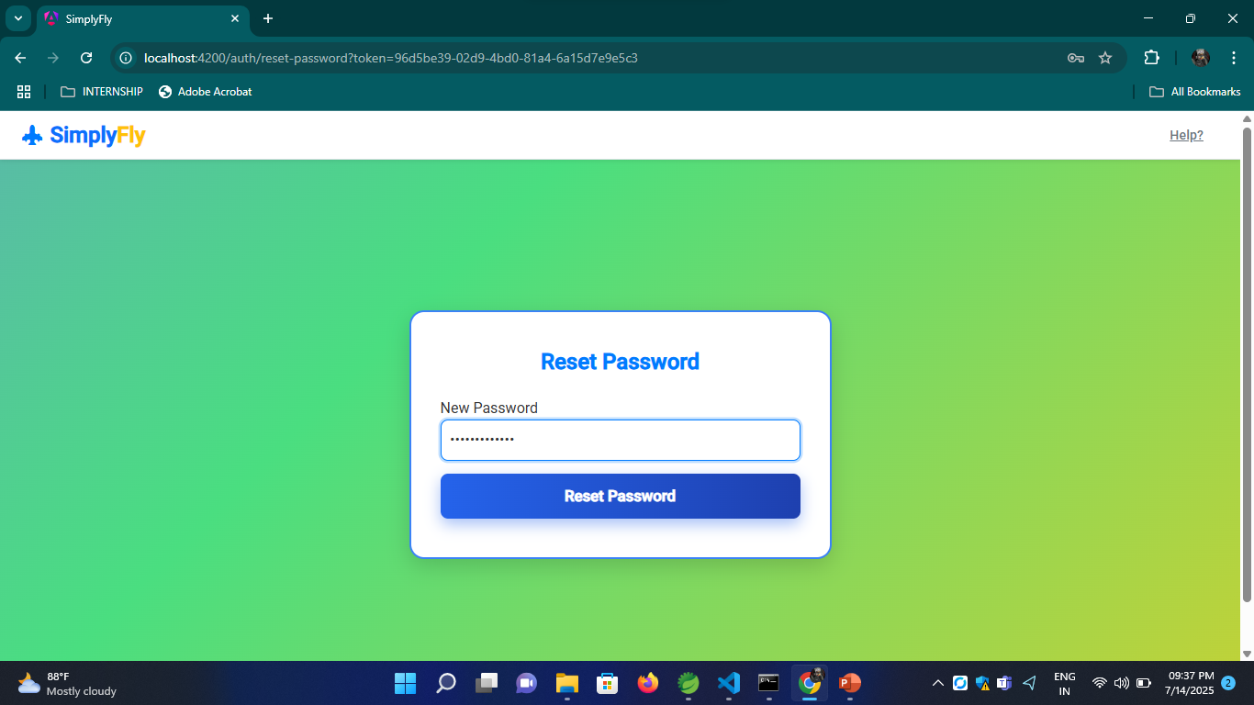
03
01
Enter a New Password

Slide 27
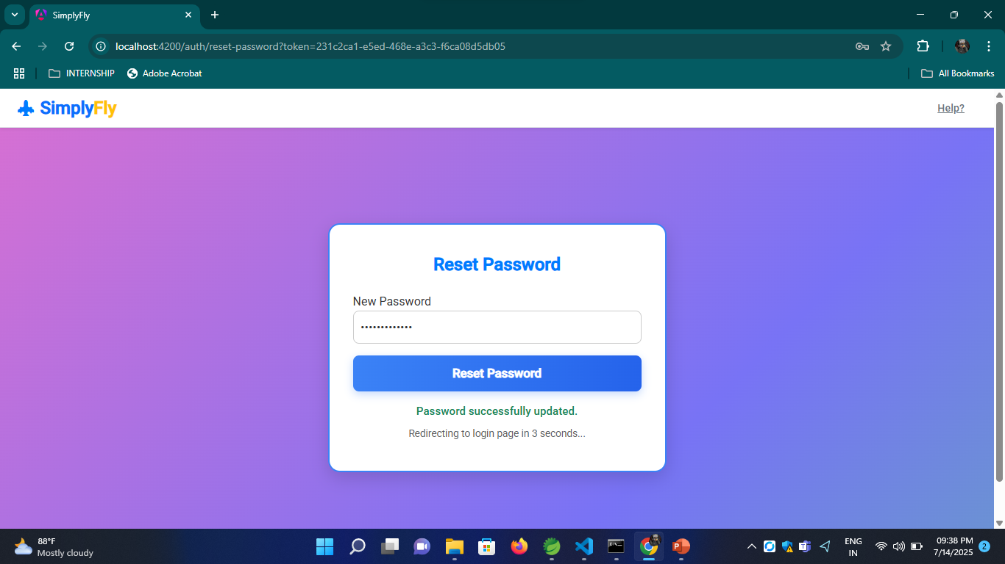
03
01
New password is updated

Slide 28
CORE FEATURES
2. Flight Owner:
Login to manage flights
Add/edit/remove routes with full details:
Flight name, number, timings, fare, baggage info
View user bookings
Refund processing for cancellations
03
01

Slide 29

03
01
Register

Slide 30
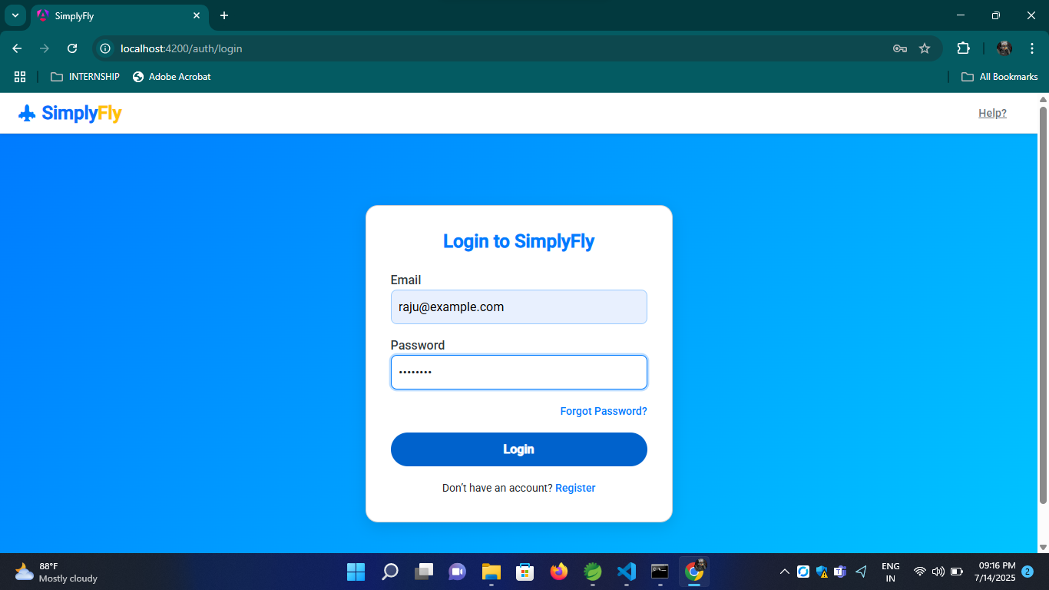
03
01
Login

Slide 31
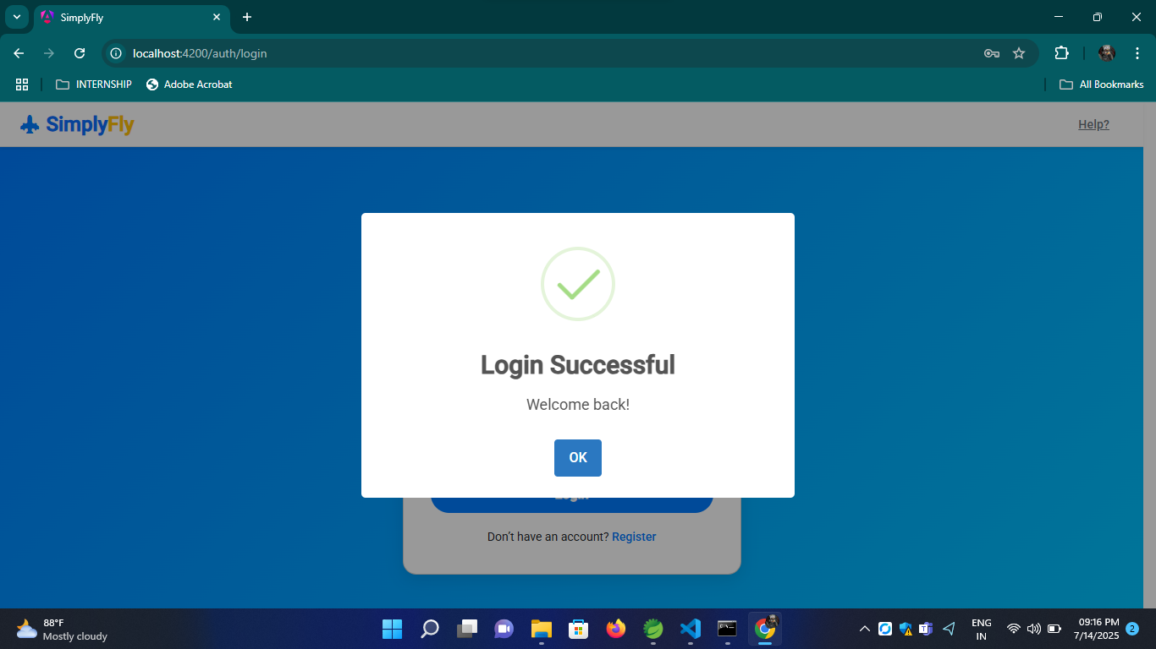
03
01
Logged In

Slide 32
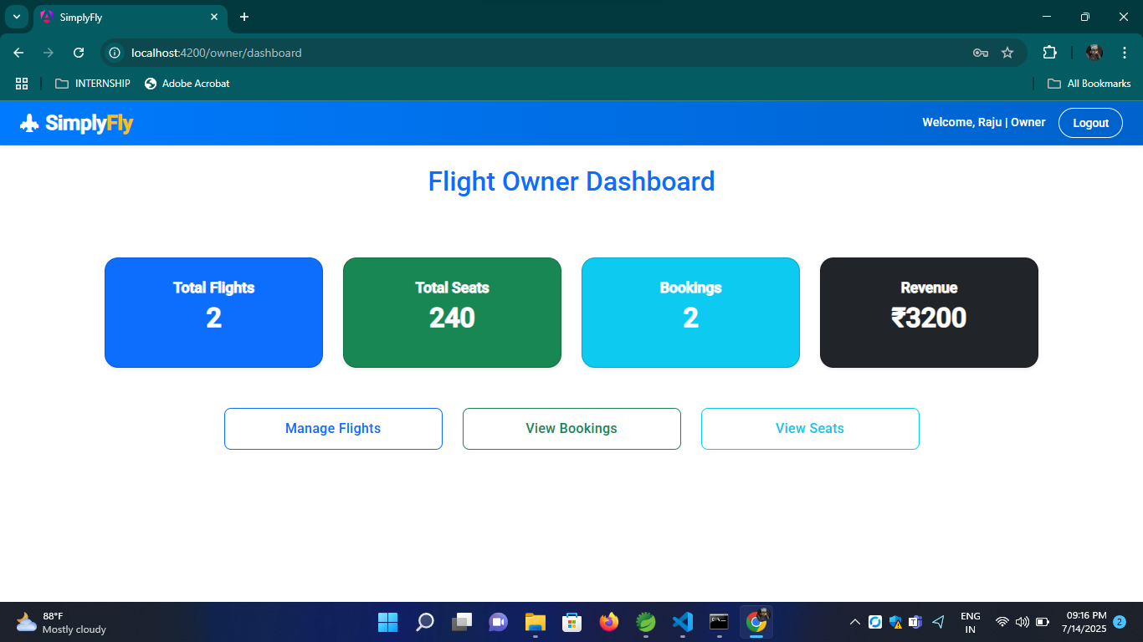
03
01
Dashboard

Slide 33
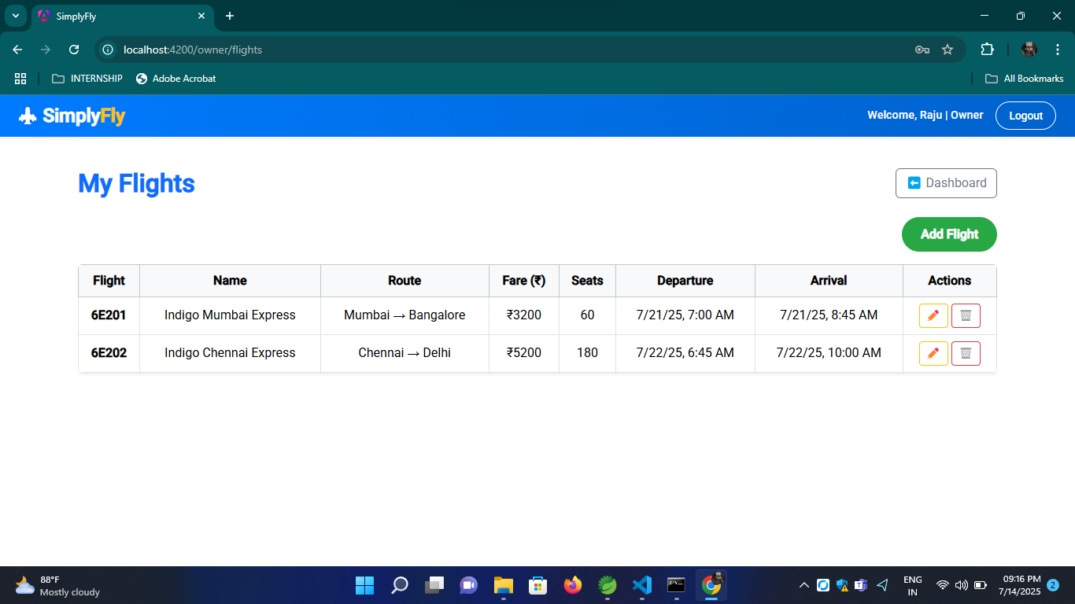
03
01
Manage Flights

Slide 34
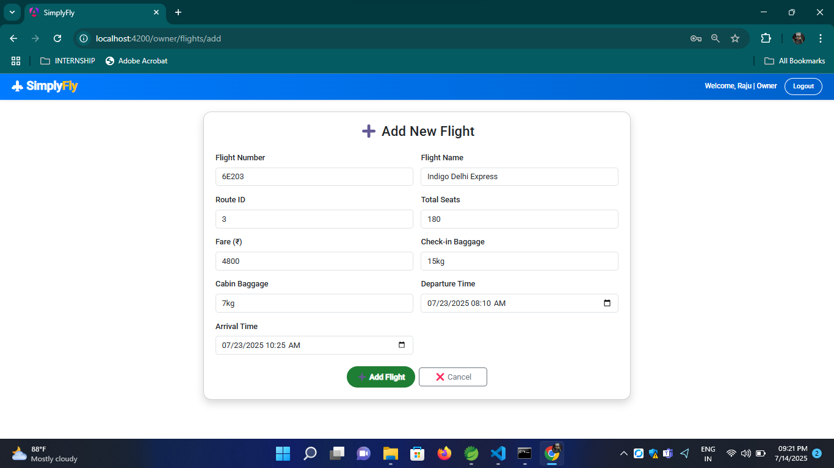
03
01
Add new flight

Slide 35
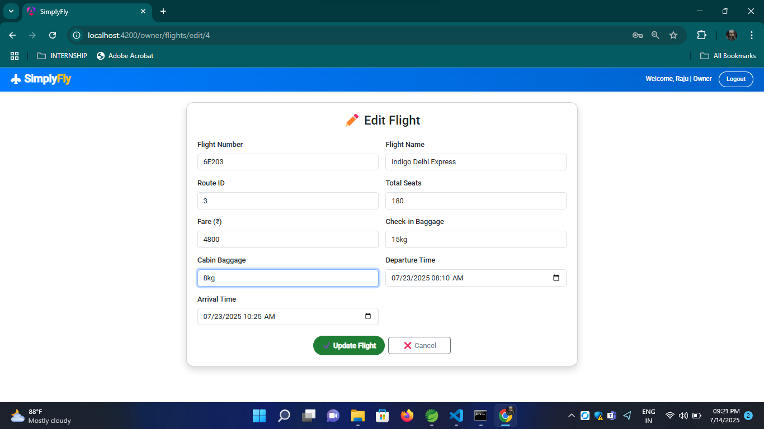
03
01
Update an existing flight details

Slide 36
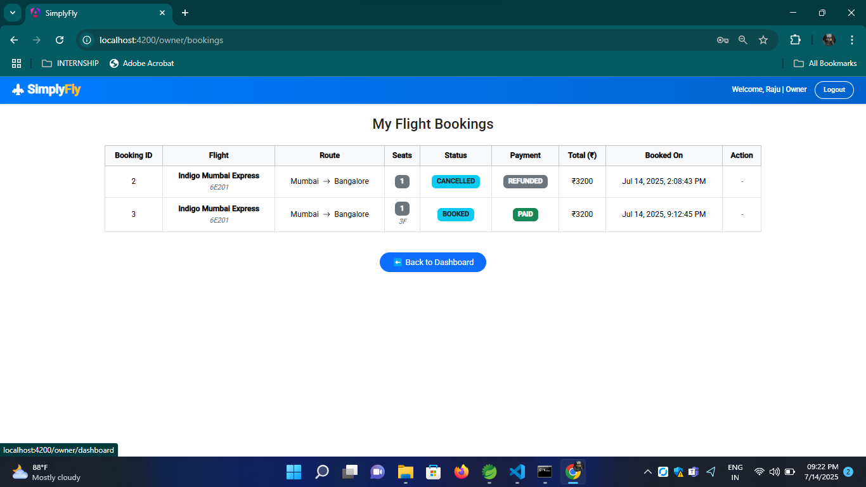
03
01
Booking History

Slide 37
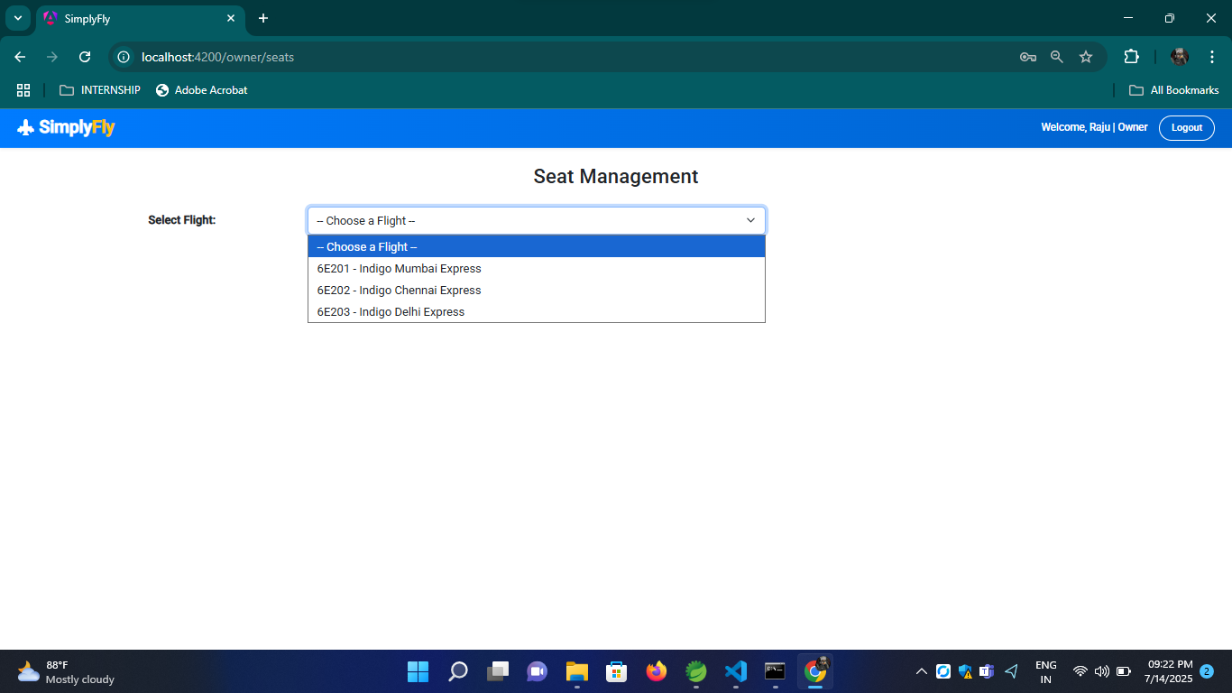
03
01
Choose a flight

Slide 38
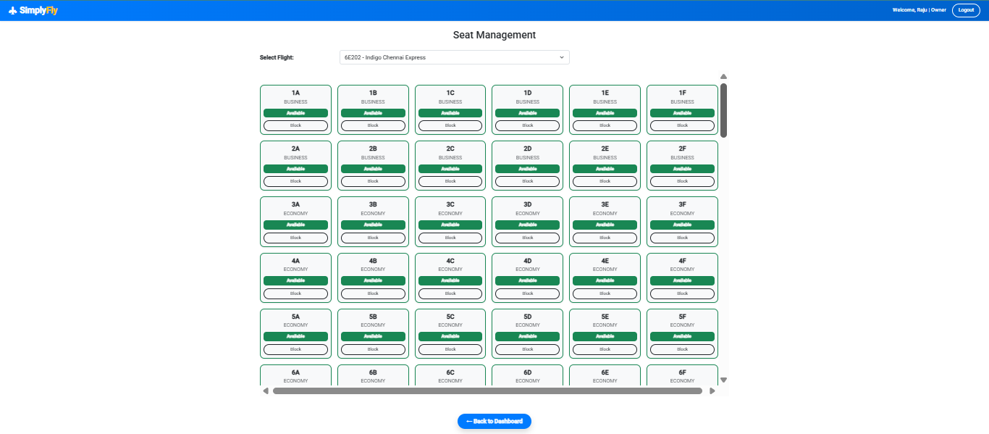
03
01
Seat status

Slide 39
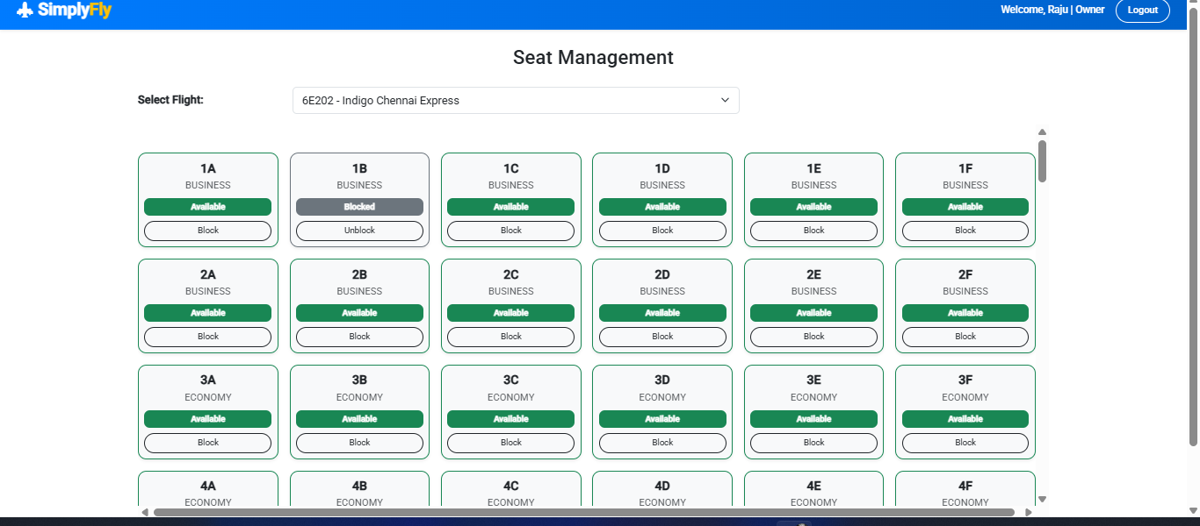
03
01
Block seat

Slide 40
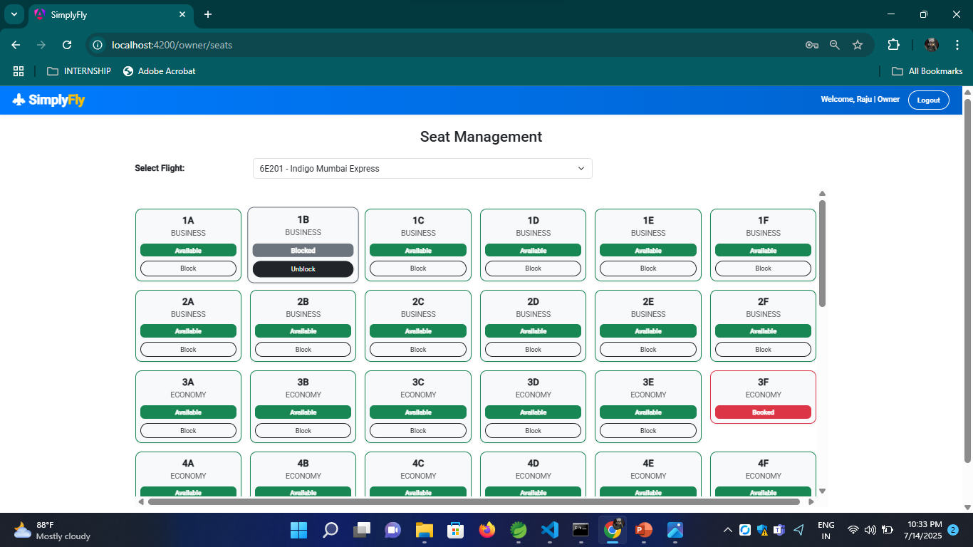
03
01
Unblock seat

Slide 41
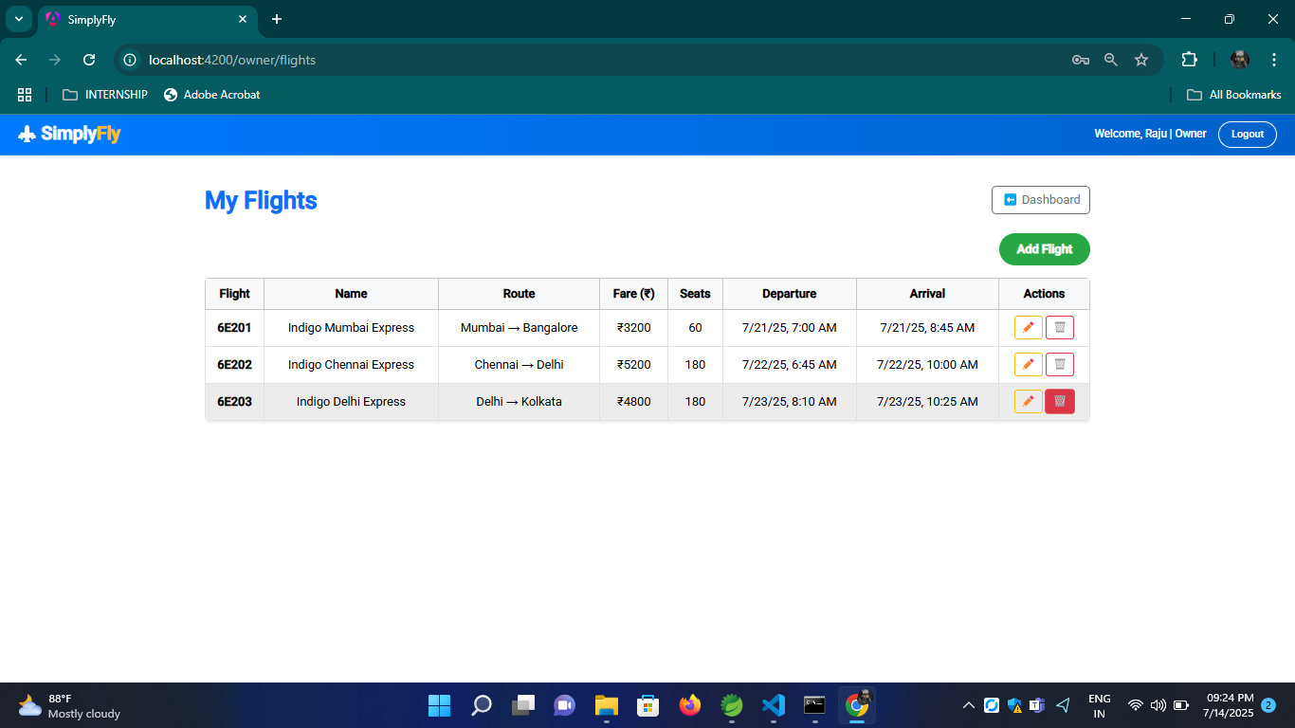
03
01
Manage Flights – View/Add/Edit/Delete

Slide 42
03
01
Logged Out

Slide 43
CORE FEATURES
3. Administrators:
Manage users and flight owners
Manage routes and booking data – add, update, delete, view
03
01

Slide 44
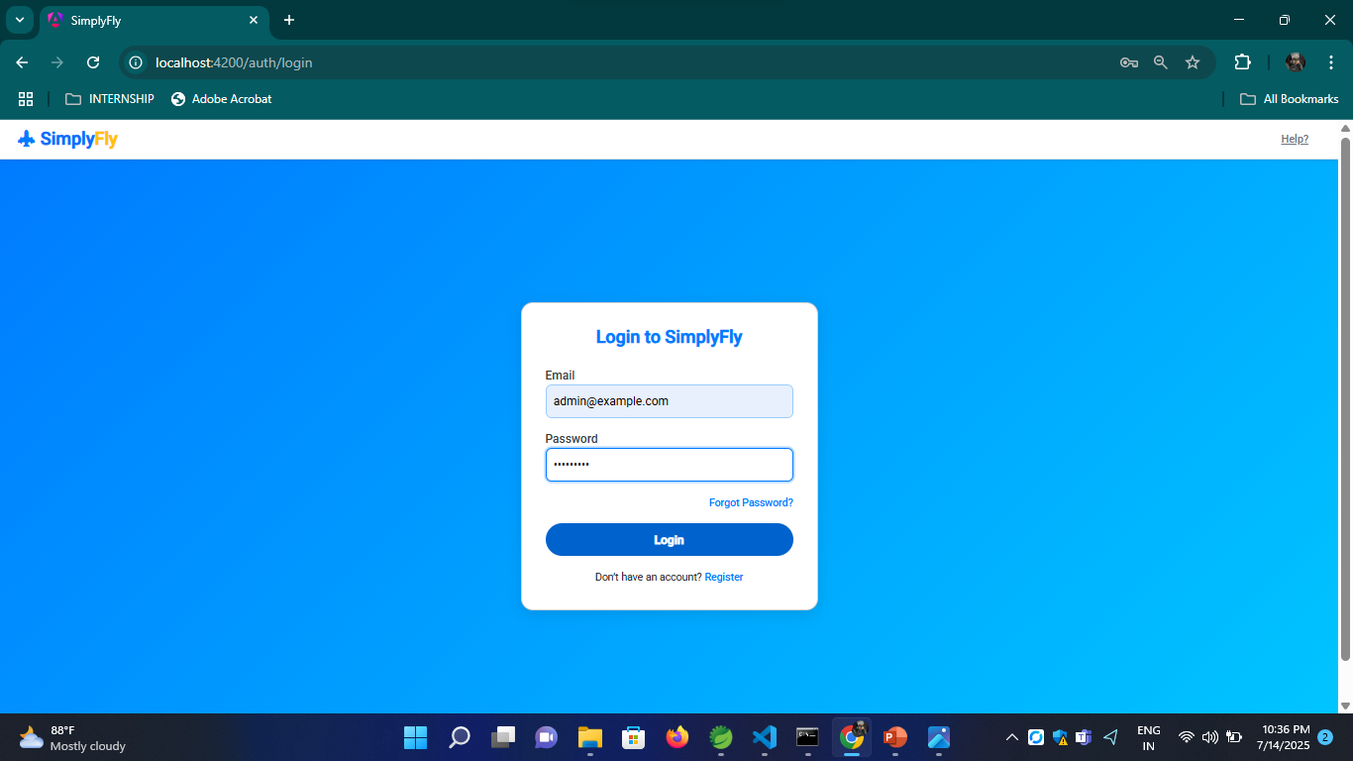
03
01
Login

Slide 45
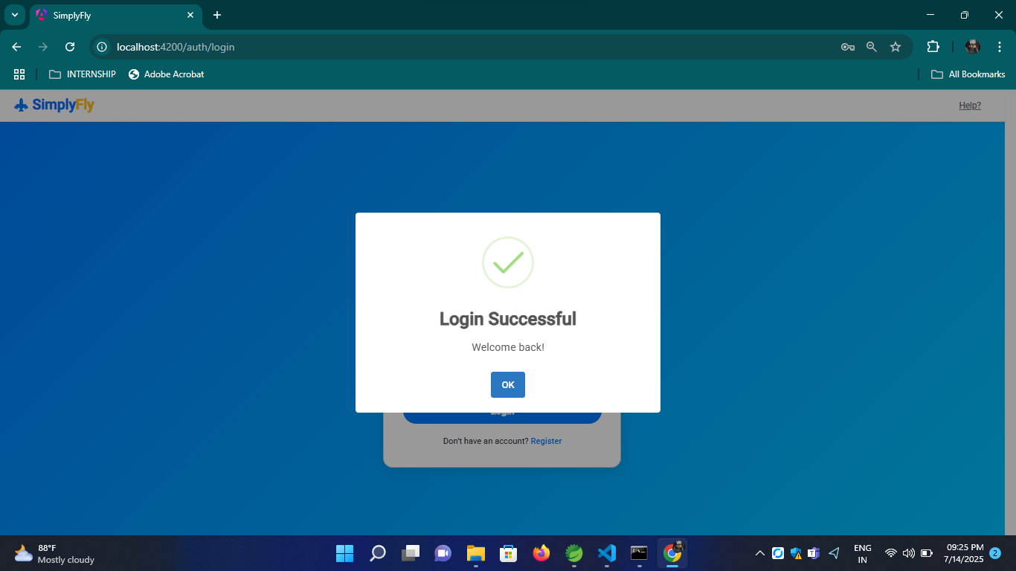
03
01
Logged in

Slide 46
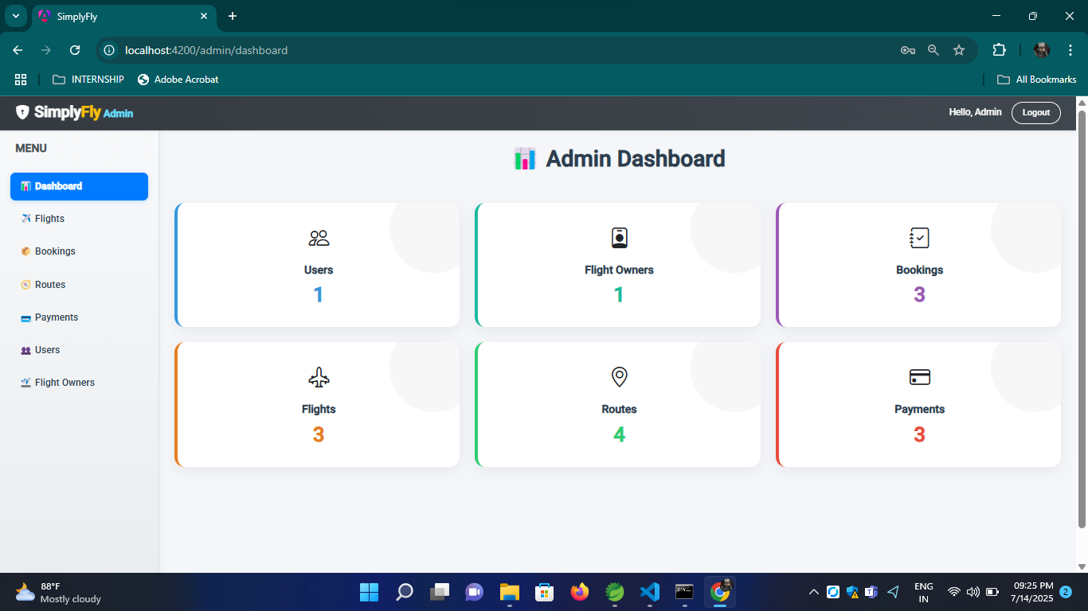
03
01
Dashboard

Slide 47
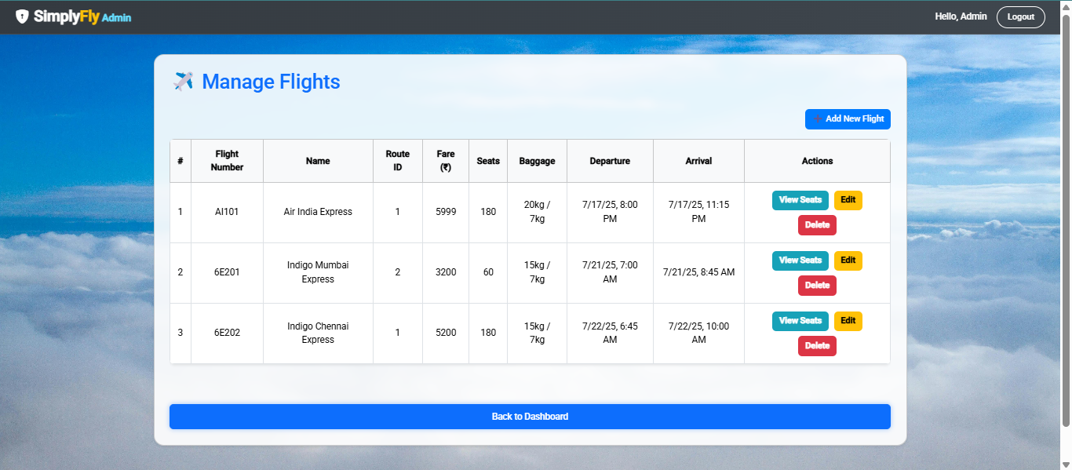
03
01
Manage Flights - Add/Update/Delete/View Seats

Slide 48
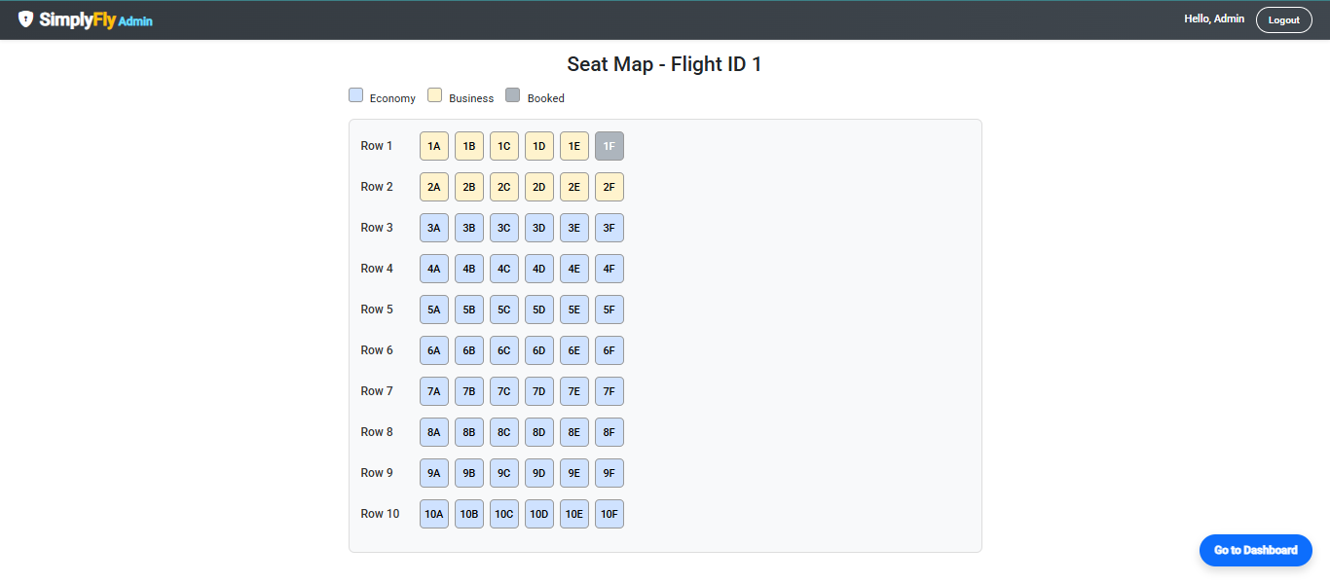
03
01
Seat Management

Slide 49
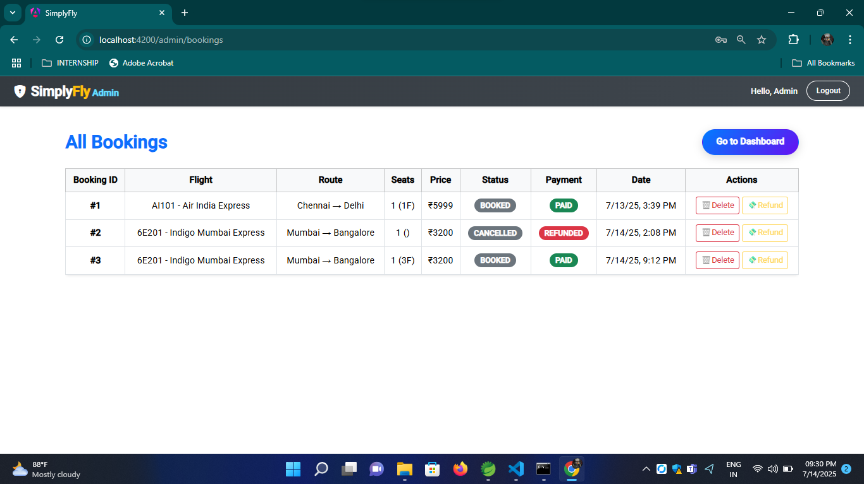
03
01
Manage Bookings – Add/Delete/Refund

Slide 50
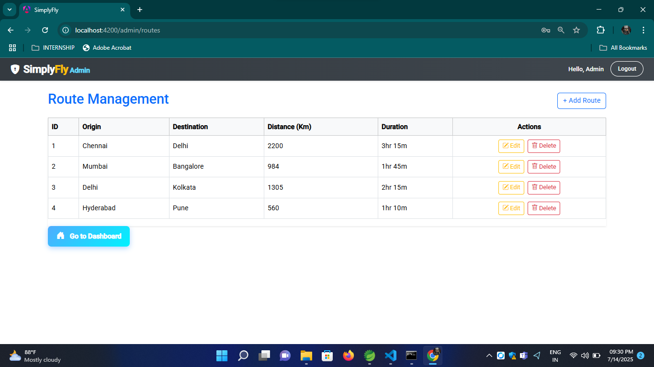
03
01
Manage Routes – Add/Edit/Delete/View

Slide 51
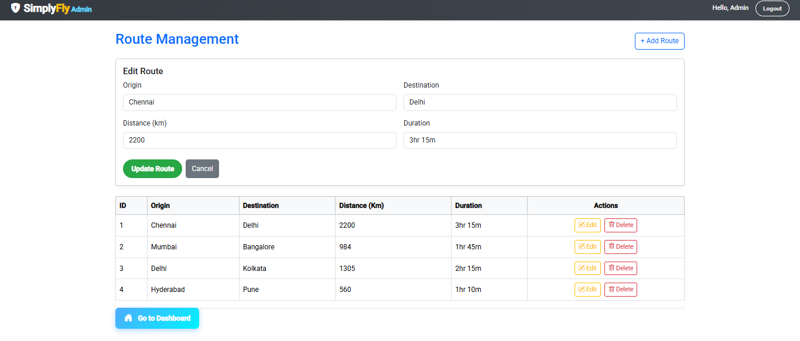
03
01
Edit Routes

Slide 52
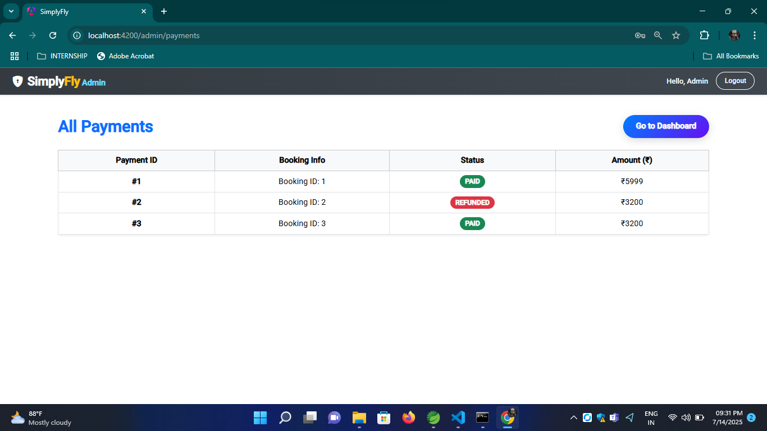
03
01
Manage Payments – View/Refund

Slide 53
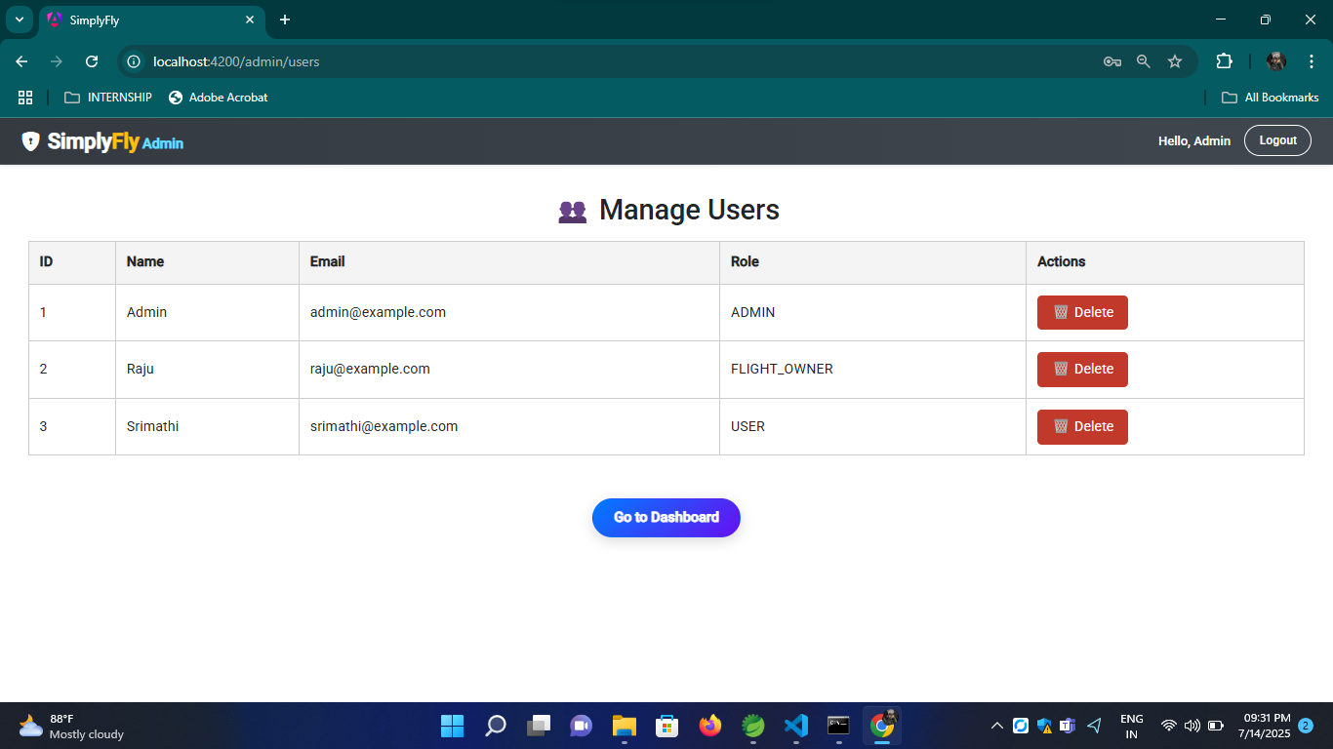
03
01
Manage Users

Slide 54
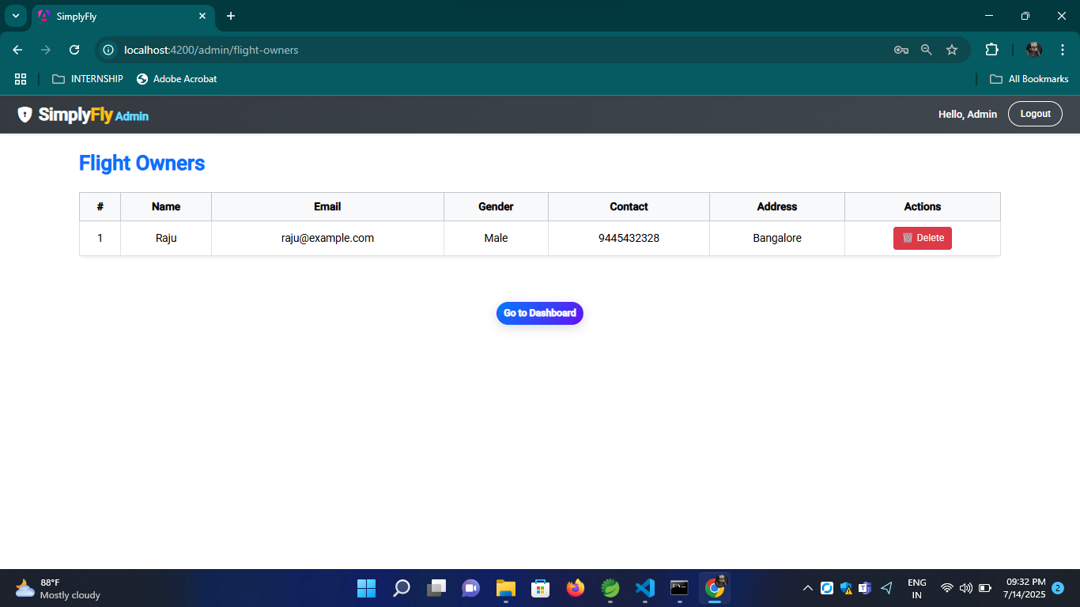
03
01
Manage Flight Owners

Slide 55
03
01
Logged Out

Slide 56
03
01
THANK YOU

